Slide 1
AUTOMATIC PLANT WATERING POT
Flovepal

Slide 2

Problem Statement
1
2
3
Problem 1
Problem 2
Problem 3
Unable to water plants.
Not taking care of the plants.
Decrease in oxygen and psychological disturbances.

Slide 3


Solution 1
1
Automatic Plant Watering Pot.
Solution 2
2
Add-on services for customers.
Solution 3
3
A platform so customers easily contact.

Slide 4
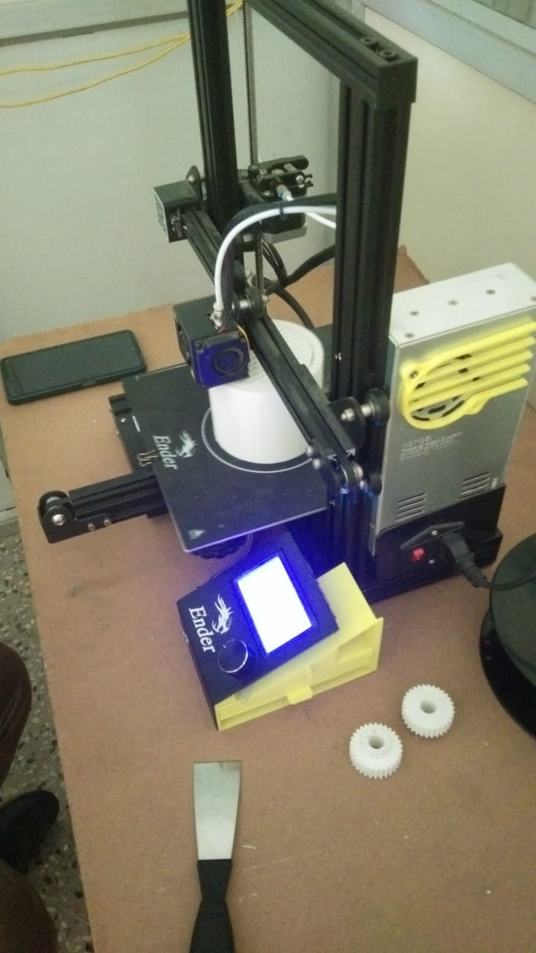

Product/ Service
A pot with Least energy consumption and maximum water storage;
Monthly service for customers with a package subscription.

Slide 5



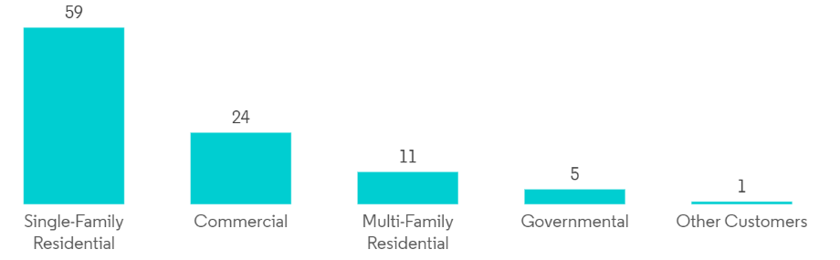
Target Market
Who are the customers you want to cater to?
Market Type
Market Segment
Nature lovers in urban families.
Environmentalists in Apartments

Slide 6
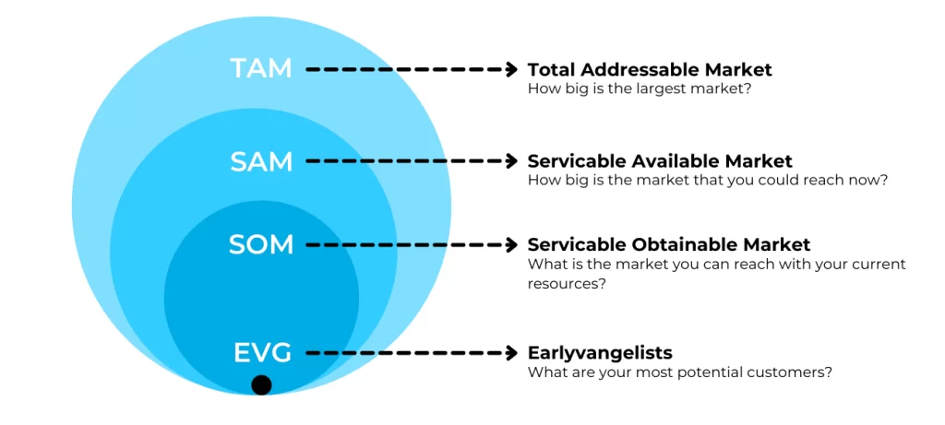

Size Of The Market
350 mln customers
80 mln customers
2 mln customers
1000 families

Slide 7
Competition Analysis
Direct
Competitors
Revaj Enterprises, Maharastra.
Gardencia Technology, Gujarat.
Ecoscapes, Maharastra.
Indirect
Competitors
Pioneer Agro Industry, Tamil Nadu.
Babilonia, Brazil.
Ramco industries Ltd, rajapalayam.

Slide 8
Advantage 1
Advantage 2
The responsibility of the plants we sell will be upon us.
Technology driven pot benefit the customer.
Competitive
Advantages
Advantage 3
Advantage 4
The chosen technology will conserve energy and minimal use of water-no restriction on pot size.
End to end assurance for 100%productivity of plants.

Slide 9

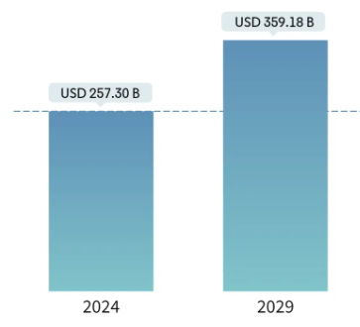

Business Model
Income by the sales of the Automatic plant watering pot.
Estimated market for indoor planting and gardening
Income by the sales of the cultivated plants and fertilizers.
Income by the subscription of service schemes.

Slide 10

Future Roadmap
What are your next steps and goals? How much support do you need from investors and what will it
Step 1
Step 2
Step 3
Step 4
Interface where customers can contact us.
Gradual increase in the circumference of service.
Physical shop where people can come and interact.
Get a small deployable team.

Slide 11
Thank You

